Slide 1
Price, Sustainability Ratings & Consumer Interest in Fashion
A Data-Driven Analysis (Good On You + Google Trends + Index Scores)

Slide 2
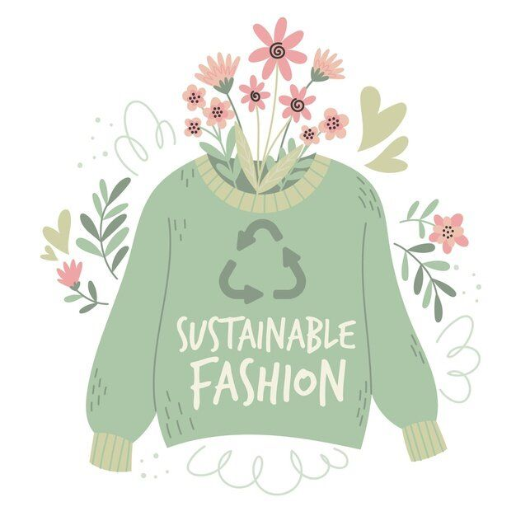
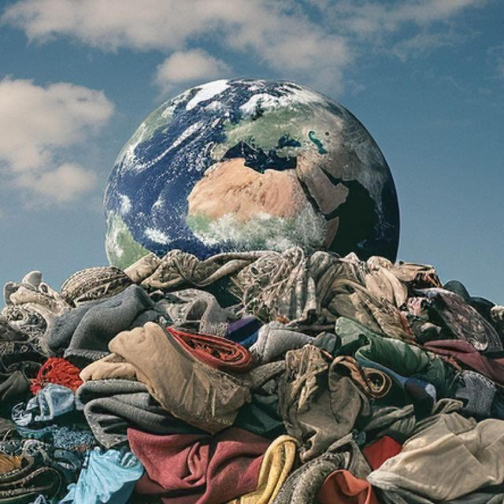
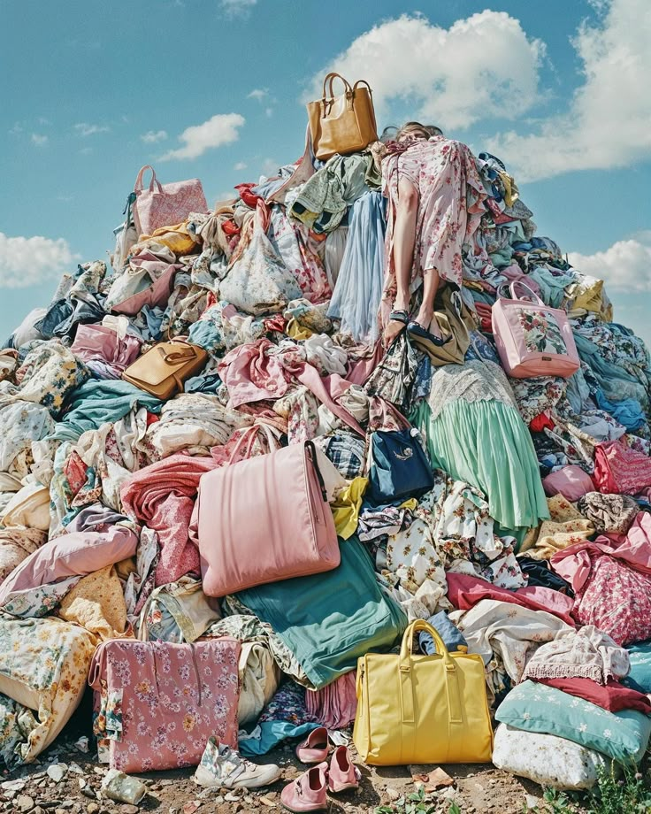

Slide 4
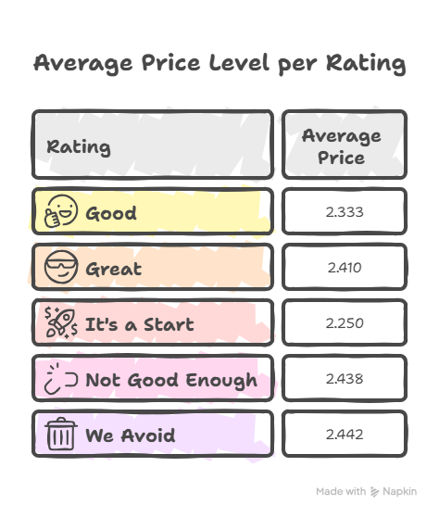
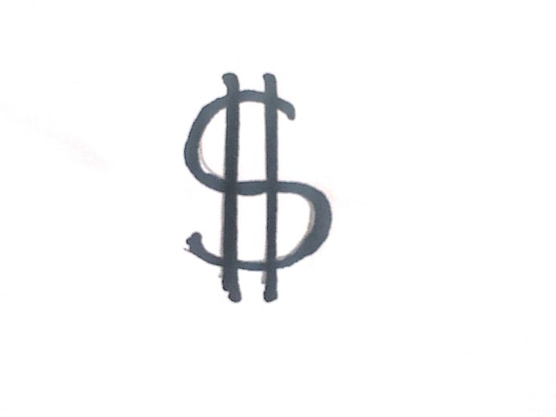











Slide 6
No Linear Relationship
Nearly zero
Correlation = –0.031

Slide 7
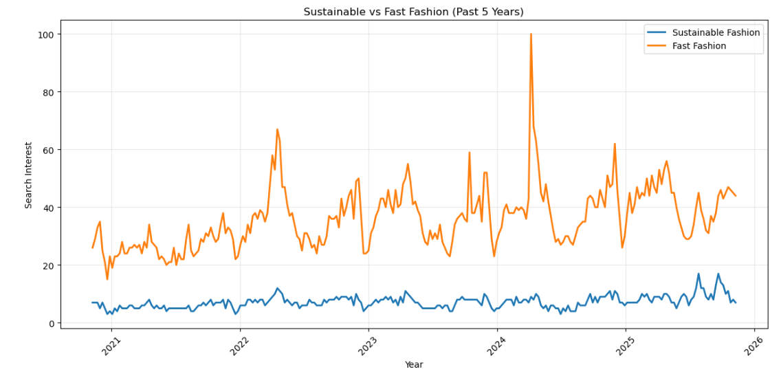

Slide 8
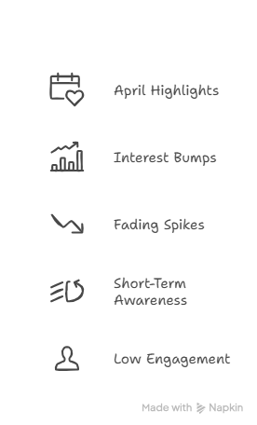
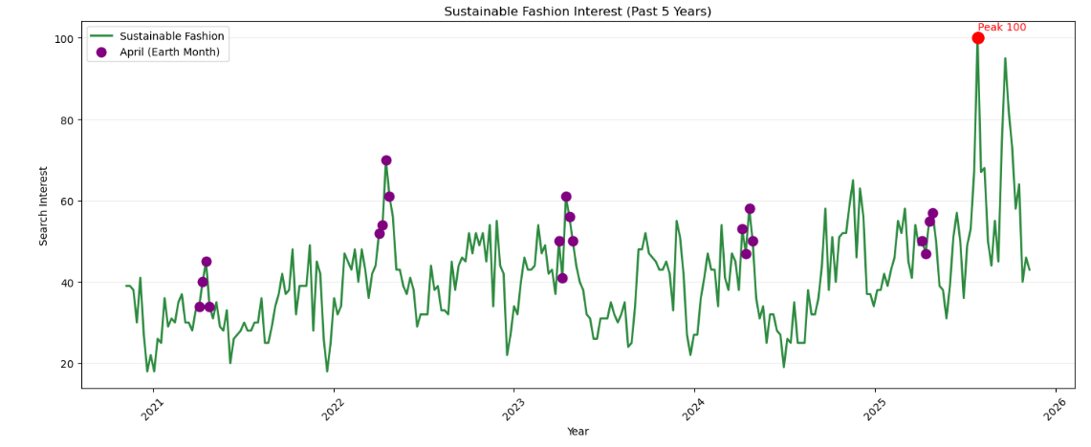

Slide 9
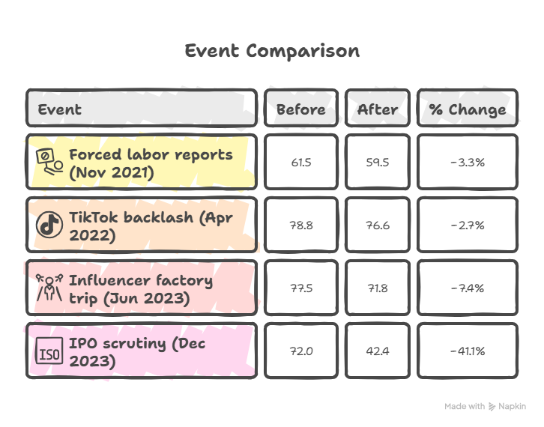
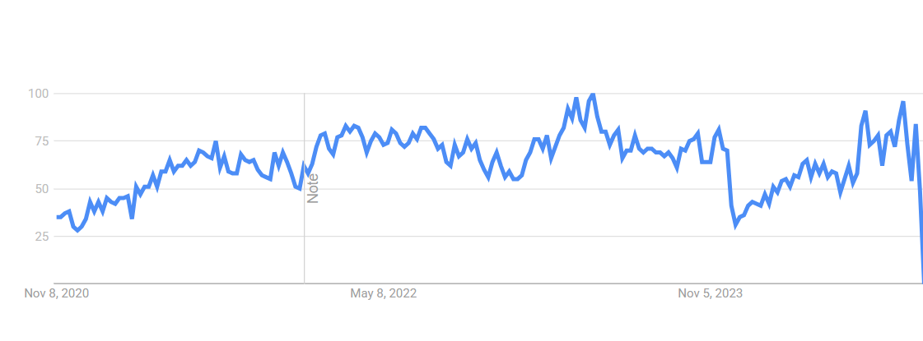
Shein Shopping Interest
Nov 24, 2021 – Forced labor reports
Interest
Apr 15, 2022 – TikTok backlash
Date

Slide 10
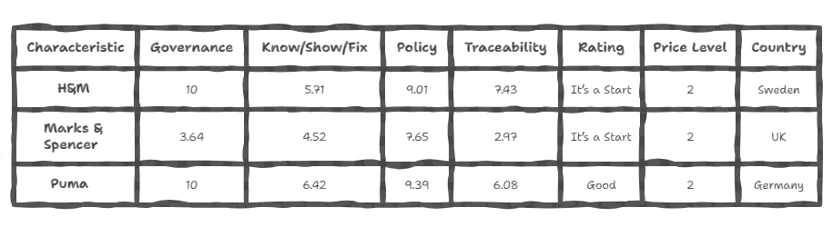
Index Scores
Notes:
why

Slide 11

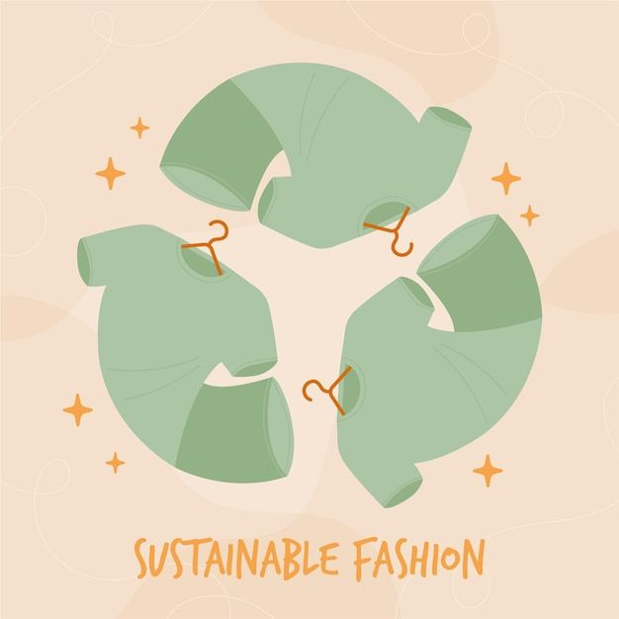
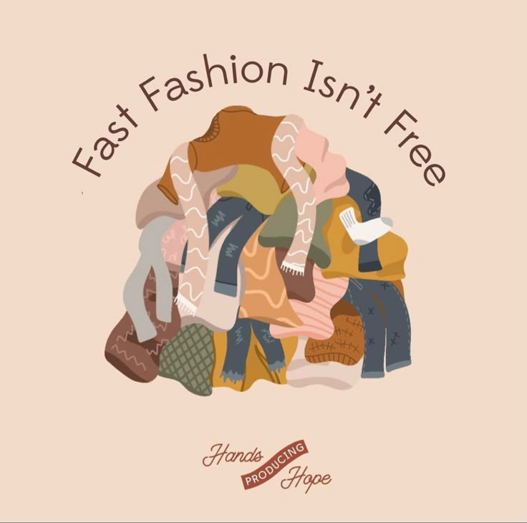
Key Takeaways
Price doesn’t determine sustainability — all categories share similar price ranges.
Most brands, sustainable or not, fall in the mid-price level.
Consumers can afford sustainable options, but availability
and visibility are still limited.
Fast fashion dominates attention and search trends,
keeping shoppers in the same cycle.
Controversies cause short dips in interest but don’t change long-term behavior.

Slide 12
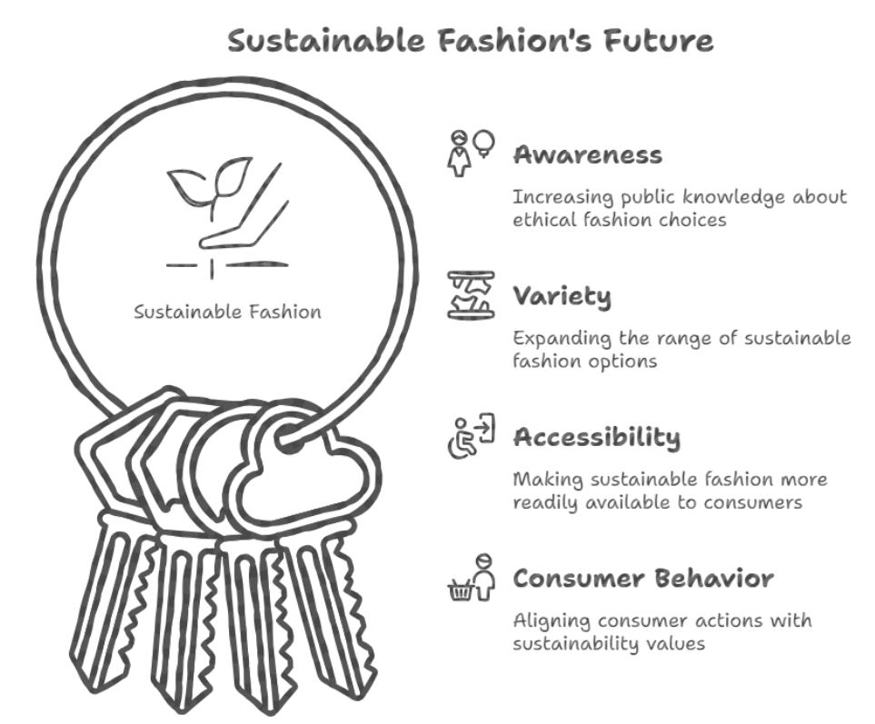
Our goals

Slide 13




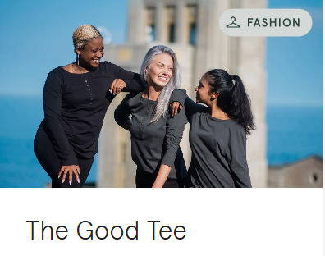
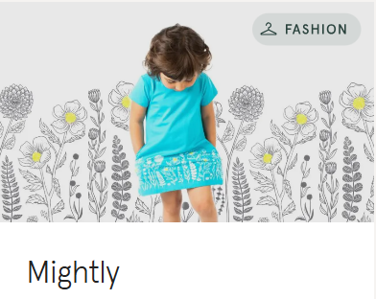
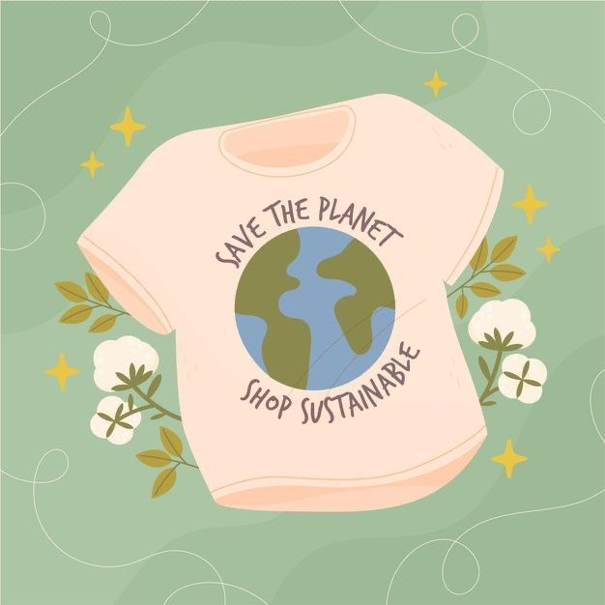
Sustainable is the New Chic

Slide 14
Thank
You!!
Notes:
hi

